Slide 1
World Interfacing
Sensing The World

Slide 2
Need To Know
An AI can exist without information about the world
E.g. A bystander in a city level
But would be very boring
And unrealistic
AI opponents, and allies, need to know what is happening around them
They need to react appropriately to the player
And other objects
E.g. doors

Slide 3
World Interfacing
Not as simple as it sounds
Needs to simulate senses
Limitations of senses
Limitations of knowledge
AI should not know everything
Unless it’s a god
Two main approaches
Polling
Event Handling

Slide 4
Senses
Not all real senses need to be modelled
Depends on game
Sight and hearing most common
Though other senses can aid game play
E.g. a dog’s sense of smell
Rare though
Real senses have limits
Distance
Lighting conditions etc.

Slide 5
Limiting Senses
Senses should not be perfect
Unfair on player
No good for stealth games
Can limit range
Just test within certain distance – very fast
Good for hearing
Line of sight checking with raycasting
Use viewcone to simulate limited angle of view
Raycast for more precise information
Good for checking target eye contact

Slide 6
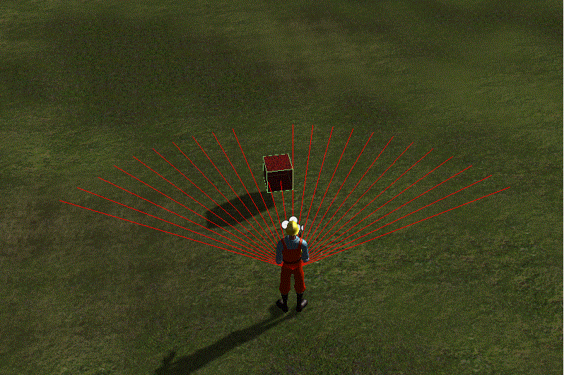
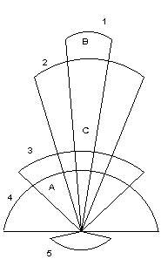
Viewcones Example

Slide 7
Handling Stealth
Shadowed areas are marked on map
AI suffers lower vision these areas
AI has lower vision in low light
AI has lower vision at long distance
Alertness state can affect vision

Slide 8
Polling
Constantly ‘ask’ the world what is happening
Simplest method
Every frame AI checks interesting objects around it
Check for collisions
Check for enemy distance
Check for location of healing kits etc.

Slide 9
Polling Pseudocode (Based On HalfLife)
Begin look Gather a list of entities within a specified distance For each entity found: If I want to look for them and If they are in my viewcone and If I can raycast from my eyes to their eyes then: If they are the player and If I have been told to not see the player until they see me and If they do not see me End look Else Take appropriate action End look

Slide 10
The Problem
Although checks are fast
As the number of AI and objects grows
Number of checks increases exponentially
100 characters requires 10,000 (n²) checks
Also difficult to debug
Information arriving in many different locations
Hard to track if right information reaching right character

Slide 11
Polling Stations
Implements centralised location for polling checks
Allows frequently accessed data to be cached
Reduces number of checks required
Easy debugging
Can run in separate thread
AI queries polling station for world state
Polling station tracks world state

Slide 12
Events
When game is more complex
Even polling station approach may not work
Events can be useful approach
Much more efficient in some situations
Events are only sent to interested agents
Only triggered when world state changes
Can be handled by centralised event manager

Slide 13
Event Manager
Stores a queue of events
Keeps track of which agents are interested in which events
Called listeners
Events can be triggered by world state change
E.g. alarm bell
Dispatches event to appropriate listener
Listener then handles event

Slide 14
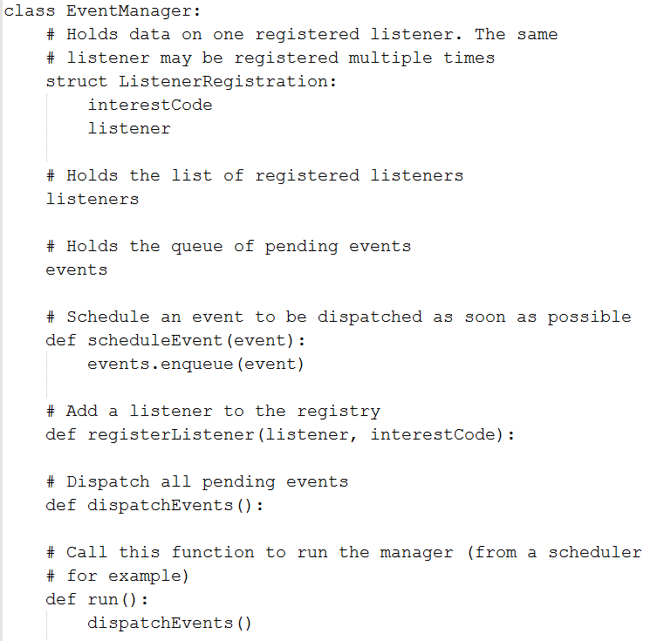
Event Manager Pseudocode

Slide 15
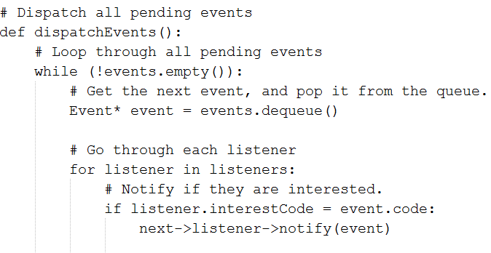
Event Dispatcher Pseudocode

Slide 16
Combining Polling And Events
It can be useful to combine polling and events
They can complement each other
E.g. Polling is inefficient when responding to a collision
Events are inefficient when checking if a door is locked
You only need to know if the door is locked when you get there
Is a specific situation suitable for polling or events
Something needing to be broadcast to many things use events
Something needing to be checked occasionally by single entity, use polling

